Slide 1
Health TechNet - Telemedicine
September 2014

Slide 2
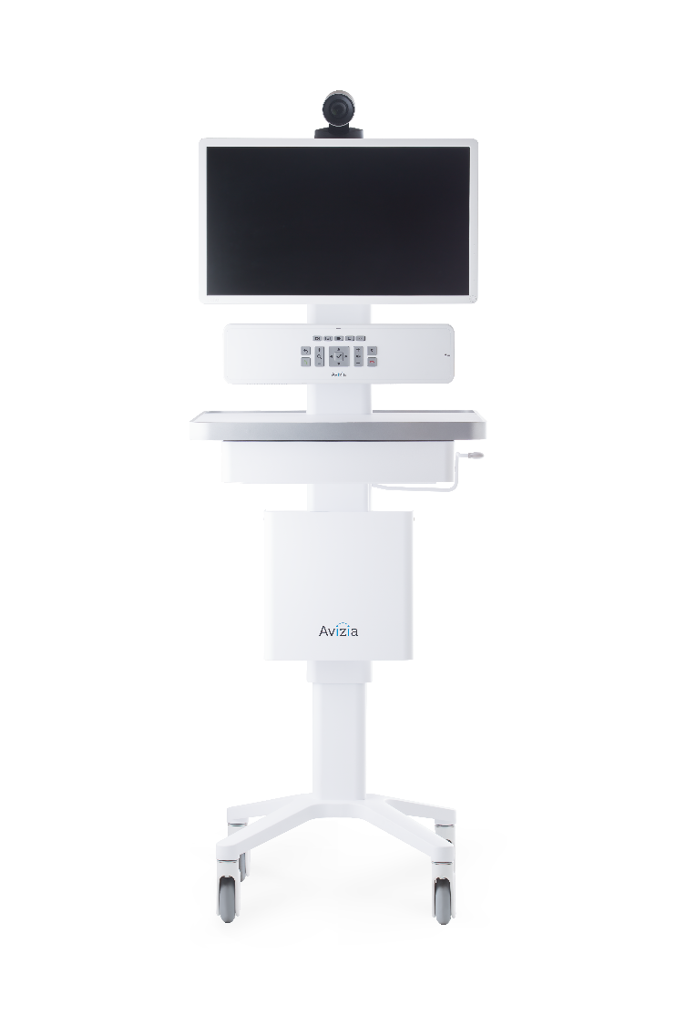
Background
Founded in April 2013 from a successful business unit within Cisco Systems
Provider of industry leading telemedicine solutions
Sold products to over 200 customers in 32 countries

Slide 3
Topics
What you may already know about telehealth
Current and future trends
How solutions are emerging to take advantage of trends

Slide 4
What you may know already
Telemedicine or telehealth is connecting patients to the right doctors at the right time, regardless of the distance
Technology, especially video conferencing, is a key enabler
AMA recently released a statement and guidelines in support of telemedicine:
“The AMA believes that…telemedicine could greatly improve access and quality of care”
Notes:
Historically, telemedicine or telehealth has been about connecting patients to the right doctors at the right time, regardless of the geographic distance between them
Technology, especially video conferencing, is a key enabler to create these in-person like consultations
Federation of State Medical Board (FSMB) – defined telemedicine

Slide 5
Quick facts
Started about 40 years ago with NASA looking to treat astronauts remotely
Market estimates vary but agree that the size is significant and growth will be strong
Estimated that over 350,000 telemedicine consults are performed each year
Medicaid and Medicare in all states currently reimburse for telemedicine consults
21 states require private insurers to reimburse
Notes:
[On the 350,000 visits point] While 350,000 is a significant number there is lots of opportunity to grow, especially as you compare it to the 130 million visits to the ER that occurred just last year in the US (source: Centers for Disease Control and Prevention).
Growing to 7M in 2018

Slide 6
Telemedicine benefits patients, doctors, and providers
Stakeholder
Telemedicine benefits
ROI
Improves access to care
Reduces travel time
Access to 50% more specialties
Saved 8.9 million miles of patient travel
Patients
Enables doctors to spend more time seeing patients, not traveling or shuttling across town
Improves patient outcomes (e.g. reduce stroke mortality after hours)
119% increase in billing revenue
44% drop in readmissions
Doctors
Reaches more patients with existing resources
Reduces unnecessary and high-cost trips (key component of outcome based compensation)
Reduces costs per visit
Improves patient satisfaction
67% increase in hospital revenue
43% reduction in high-cost transfers
35% drop in costs per ER visit
30% improvement in patient satisfaction
Healthcare systems
Source: University of Virginia Health System, Geisinger Health Plan, UC Davis Health, HealthPartners, Department of Defense

Slide 7
Telehealth is more than just video
Synchronous (e.g., live video)
Asynchronous (e.g., store-and-forward)
Remote Patient Monitoring / Home Health
Electronic Health Records
mHealth
Notes:
Today and in the future telehealth is more than just getting a patient to the right doctor at the right time.
It’s empowering people and medical professionals with tools and solutions to help them collaborate together to revolutionize how health is managed

Slide 8
Several key trends will drive telehealth
Explosive growth in healthcare demand and a shortage of doctors
Changes in how providers get paid
Doctors without borders
Consumer adoption of mHealth

Slide 9
Major trends are driving an explosive increase in demand for care…
Aging Population
Percentage of the US population >65 years old will increase from 13% in 2010 (40M) to 20% (80M) in 2040
More than 10,000 Americans turn 65 each day
Increased Prevalence of Chronic Disease
By 2025 chronic diseases will affect almost half (49%) of the population
Chronic diseases account for 81% of hospital admissions, 91% of prescriptions filed, and 76% of all physician visits
ACA Mandated
Market Changes
The Affordable Care Act (ACA) will extend health insurance coverage to almost 33 million people who were previously uncovered – and stretching the existing system.

Slide 10
…which coupled with a slower increase in Physicians is creating a significant challenge
Supply and Demand of Physicians in the U.S.
Number of physicians
09/17/14
09/17/14
Projected gap of ~130,000 doctors in 10 years
Source: Association of American Medical Colleges

Slide 11
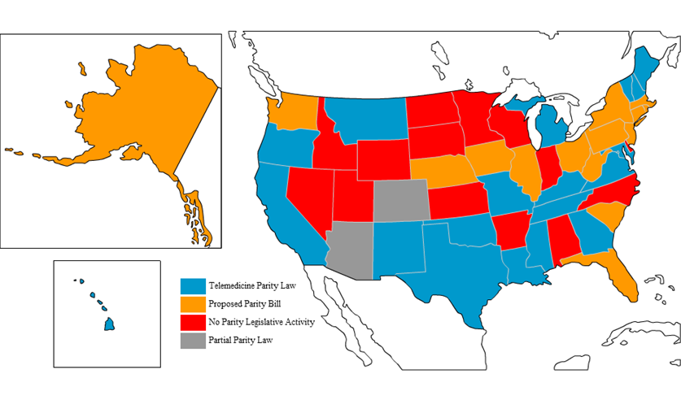
How providers get paid is changing
From fee for service to accountable care
Growing support for telemedicine reimbursement
Old
New
Pay separately for every service
Incentivizes overspending
Pay set amount per patient per year with penalties for poor outcomes (e.g., readmissions)
Incentivizes performance
The number of states that require private insurers to reimburse for telemedicine is now 21 and projected to grow quickly

Slide 12
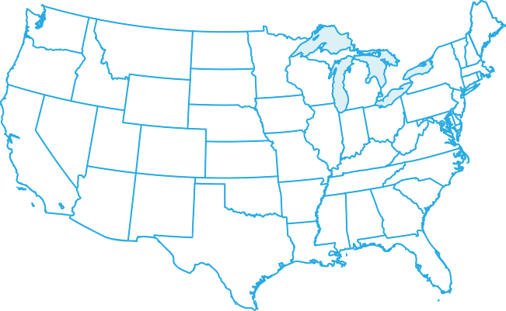
To improve quality of care, momentum is building to extend physicians’ interstate reach
Physicians practicing with the Veterans Administration can provide care across state lines
Multiple bills have been proposed in the House of Representatives recently
46 Bills currently before congress
40 States working on legislation for telehealth policy
Telemedicine for Medicare (TELE-MED) Act – September 2013
The Telehealth Promotion Act – January 2013
Currently a case is before the FTC about interstate dentistry that could have major implications
Source: ML Strategies, titled "Telehealth and Health IT Policy: Considerations for Stakeholders.

Slide 13
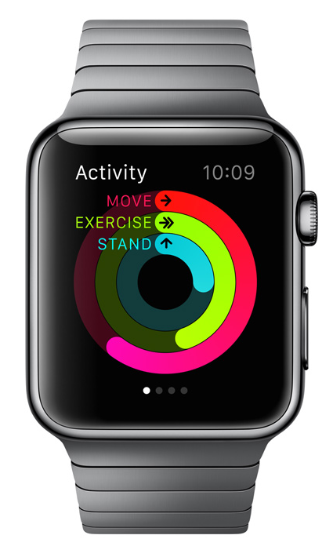
Strong mHealth adoption will get patients comfortable with technology in health
Fitness wearable sales
Units
?
3.3 Million
500%
0.6 Million
Apr 2012 – Mar 2013
Apr 2013 – Mar 2014
Apr 2014 – Mar 2015

Slide 14
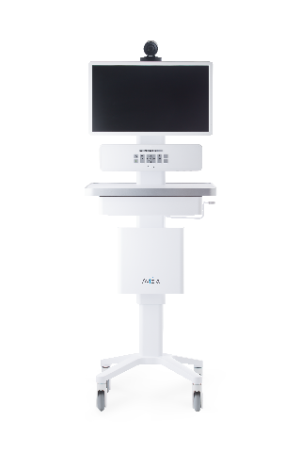
We are developing an end to end telehealth solution
Telehealth platform
Synchronous (e.g., live video)
Remote Patient Monitoring / Home Health
Asynchronous (e.g., store-and-forward)
Electronic Health
Records
mHealth

Slide 15
www.aviziatech.com

